Slide 1
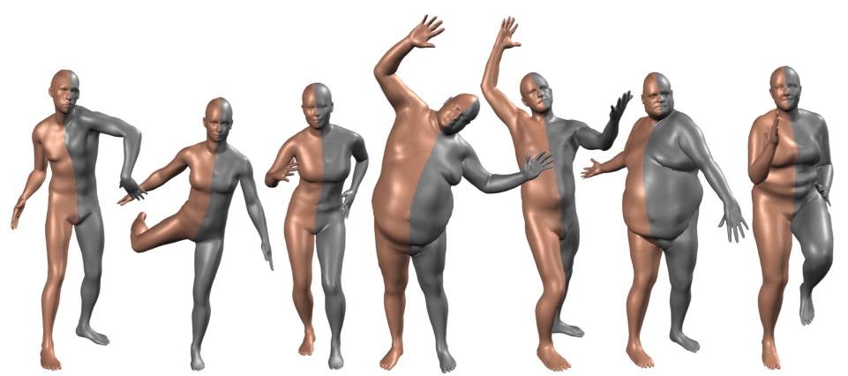
11. Keep it SMPL Automatic Estimation of 3D Human Pose and Shape from a Single Image
Thai Thanh Tuan, Young sik Yun
Create: 13th July 2021

Slide 2
Introduction
Project page: https://smplify.is.tuebingen.mpg.de/index.html
Paper: http://files.is.tue.mpg.de/black/papers/BogoECCV2016.pdf
Supplementary Video: https://youtu.be/OgX49T2Cqdo
Conference: ECCV 2016

Slide 3
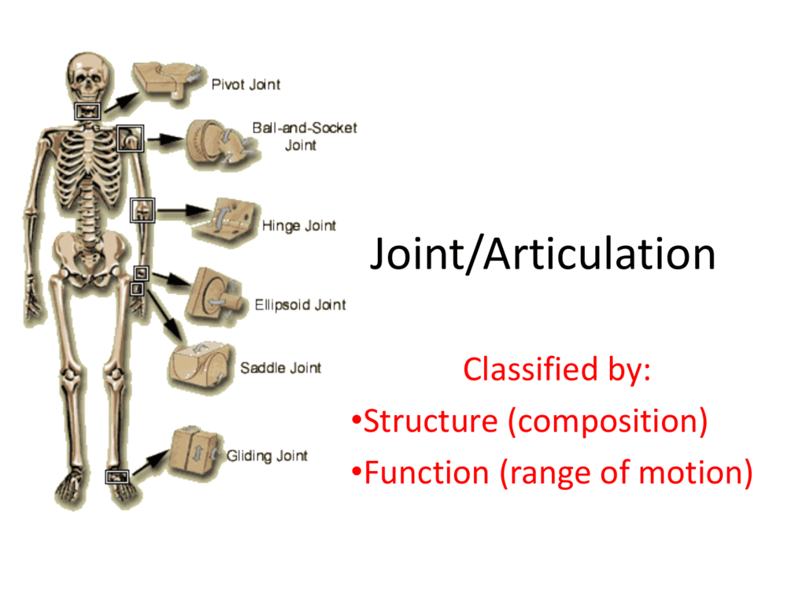
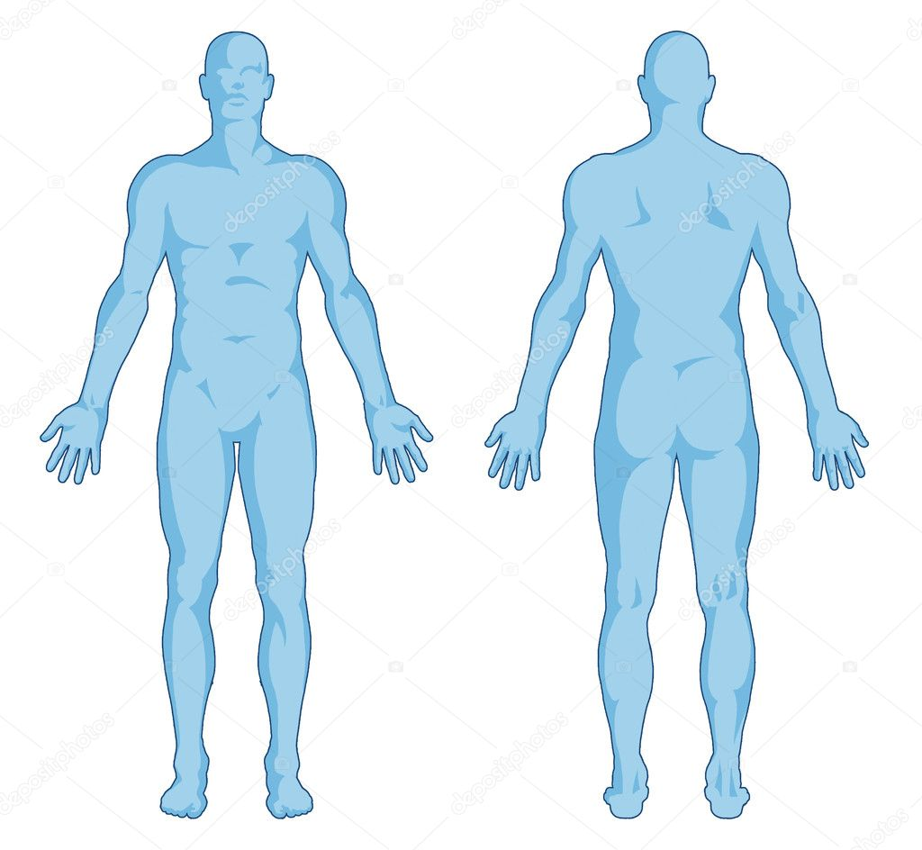
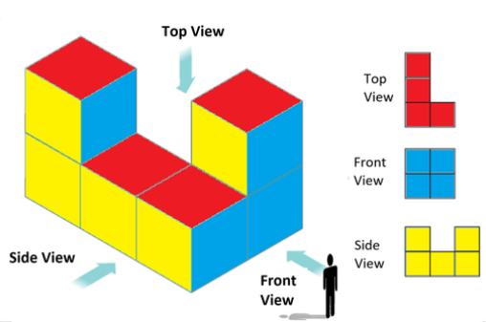
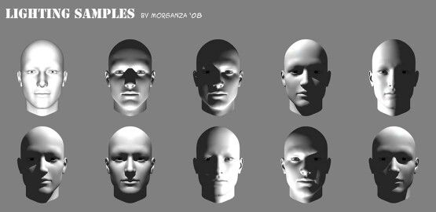
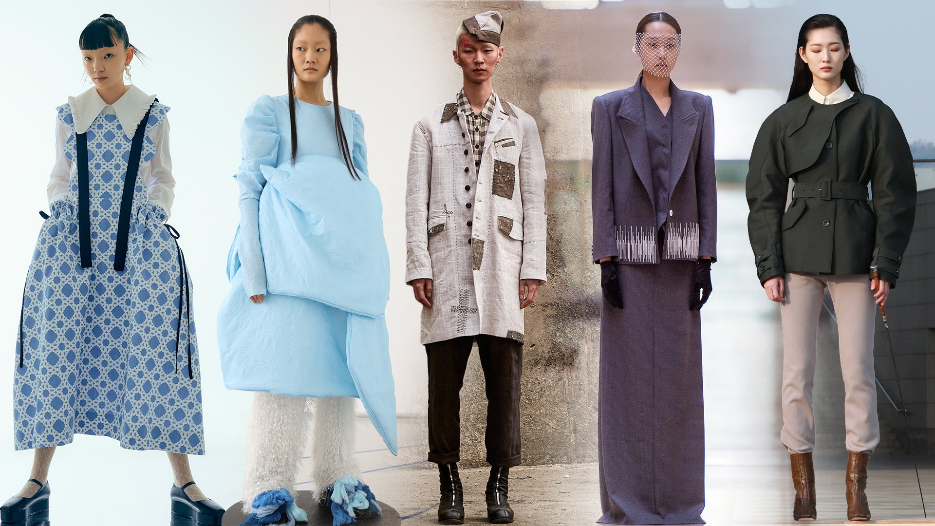
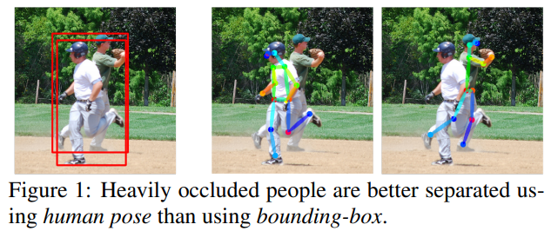
Introduction
Challenges:
Complexity of the human body
Articulation
Occlusion
Clothing
Lighting
Ambiguity in inferring 3D from 2D
Challenges
Notes:
인체의 복잡성, 다른 물체 또는 신체에 가려짐(시점), 옷에 의한 가림, 빛에 의한 어려움 등 때문에 2D에서 3D를 추정하는데 어려움이 있다.

Slide 4
Introduction
Motivation:
Many applications
Previous works only on pose and ignore 3D human shape
Evaluation:
CMU dataset [3]
Compare recently published methods [4, 39, 58]
Qualitatively
Quantitatively
Contribution:
First fully automatic method of estimating 3D body shape and pose from 2D joints
An interpenetration term
Novel objective function that matches a 3D body model to 2D joints
Provide the code/2D joints/ 3D models
Is it better to add body shape information?

Slide 5
Related work
3D pose from 2D joints:
Have weak/non-existent models of human shape.
→stronger model of body shape →reduce ambiguity
3D pose and shape:
Make it automatic:
None of the methods are automatic

Slide 6




Estimate 3D joint from 2D joint
Deep Cut
(CNN)
2D joint
(ground truth)
2D image
Error:
Template 3D body
(rest pose)
3D body model
Camera parameter
2D joint
(predicted)
Object function
optimization
Regularization term from SMPL data
Notes:
In resent study, Deep cut have been successful at estimating 2D human pose.
The initial of 3D body model is the rest pose

Slide 7


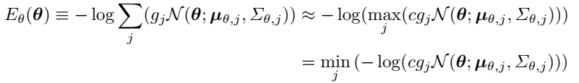


Objective function
Objective function
Joint-based data term
Pose prior (elbows and knees)
Pose prior
Interpenetration error term
Shape prior

Slide 8

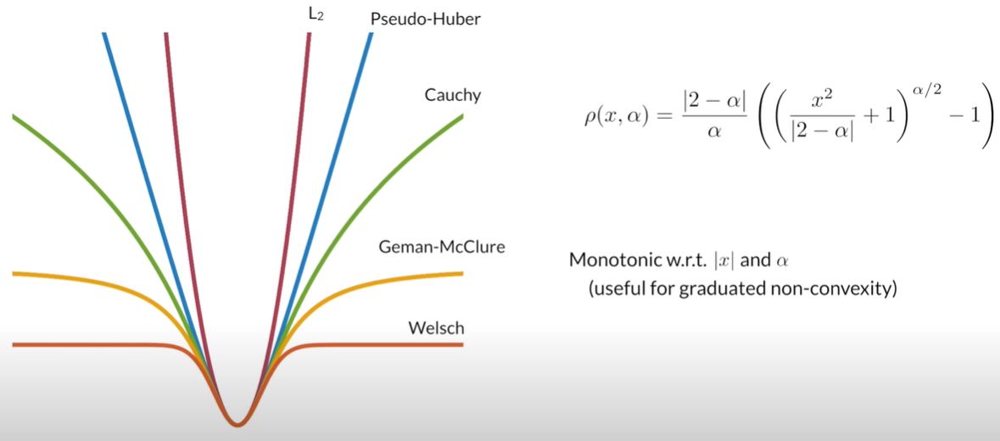
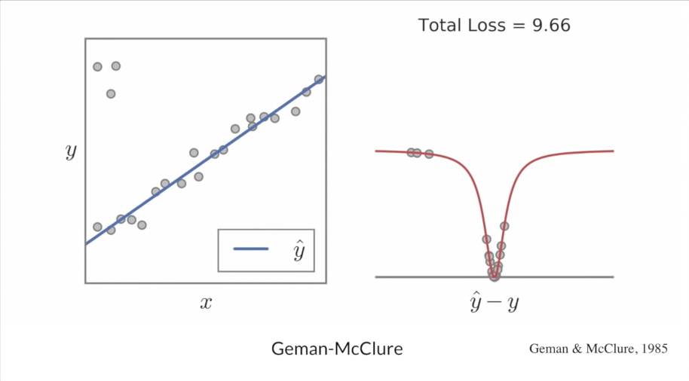
Joint-based data term
the confidence of estimated joints (Deep pose)
→occluded joints has low confidence(weight)
Noisy estimate → differentiable Geman-McClure penalty function
the projection from 3D to 2D induced by a camera with parameters K
https://www.youtube.com/watch?v=BmNKbnF69eY&ab_channel=JonBarron
Notes:
For each joint, using R, we can get the joint position. Using camera parameter K, we can project the 3D model joint into 2D. Comparing with the Deep Cut output, we can calculate the error.
Because the data is noisy, we put it in to the Geman-McClure penalty function.
Then add each joints error with weight. the weight means the reliability of the estimation, it’s from Deep Cut
base_weights = np.array([1, 1, 1, 1, 1, 1, 1, 1, 1, 1, 1, 1, 1], dtype=np.float64)
weights = base_weights * conf[cids] if conf is not None else base_weights
param conf: 14D vector storing the confidence values from the CNN(confidence=reliability of Deep Cut estimate)

Slide 9

Pose prior (elbows and knees)
Penalizing elbows and knees that bend unnaturally
Negative bending = natural → penalty goes to zero
Positive bending = unnatural → penalized high
right knee, left knee, right elbow, left elbow
Notes:
# obj3: joint angles pose prior, defined over a subset of pose parameters:
# 55: left elbow, 90deg bend at -np.pi/2
# 58: right elbow, 90deg bend at np.pi/2
# 12: left knee, 90deg bend at np.pi/2
# 15: right knee, 90deg bend at np.pi/2
alpha = 10
my_exp = lambda x: alpha * ch.exp(x)
obj_angle = lambda w: w * ch.concatenate([my_exp(sv.pose[55]), my_exp(-sv.pose[
58]), my_exp(-sv.pose[12]), my_exp(-sv.pose[15])])

Slide 10
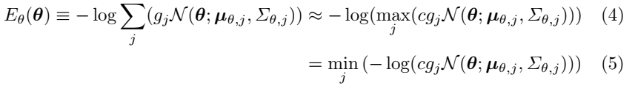


3D pose prior
3D body model
Mixture model weights of N=8 Gaussians
CMU marker data
1 million poses
Of 100 subjects
CMU dataset
Fitting a mixture of Gaussians
Approximate the sum in the mixture of Gaussians by max operator
[32]
Fitting SMPL using MoSh[29]
Positive constant c
Notes:
From the trained data we can get a mixture of Gaussian Probability function for the pose parameter. So, we put the model’s pose parameter each in the Gaussian, and add it, it’s the reliability. Using the –log function we can get the penalty. And for the compute time, we can approximate the summation as max.

Slide 11
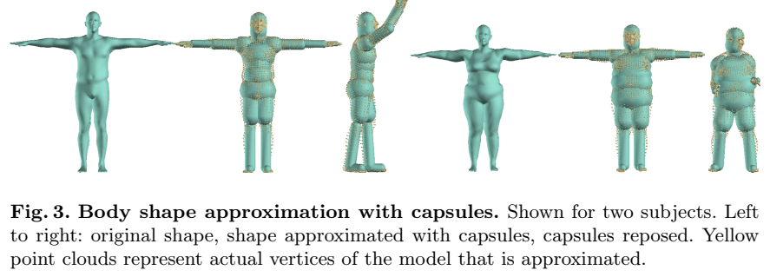
Approximating bodies with capsules
Complex, non-convex body surfaces → hard to compute interpenetration
➔follow [10,50] to use proxy geometries to compute collisions
Notes:
To reduce the interpenetration running time, we approximate the body into the capsule.
Interpenetration is a term for preventing penetration.
Model shape parameter=(training)>capsule parameter(axis length and radius)

Slide 12
Approximating bodies with capsules
Kinematic chain
+
Gradient-based optimization
cross-validated ridge regression
20
Body parts
3D body model shape parameters
Capsule regressor
Axis length and radius of capsule
Build capsule
3D body
(trained SMPL)
Body parts
Bidirectional distance
Notes:
From 3D body model we can get the beta, we put it in the regressor and get the output(capsule parameter). Using the output, we can build the capsule. Calculating the error between the 20 corresponding mesh and capsule. We can update(optimize) the weight of regressor.

Slide 13

Interpenetration error term
Along the capsule axis and radius
Along the capsule axis and radius
Center of sphere
Mixture of 3D Gaussians model in [47]
The spheres incomparable with i
➔ Would bias the body shape to be thin ➔Not use in optimizing shape.

Slide 14

Shape prior
A diagonal matrix with the squared singular values estimated via Principal Component Analysis from the shapes in the SMPL training set.
Note that the shape coefficients β are zero-mean by construction
Notes:
E is 0

Slide 15

Optimization
On torso joints
SMPL
Camera translation and body orientation are unknown
The camera focal length or its rough estimate is known.
Side view
Starting with high value then decreasing
Torso length of mean SMPL shape
Via the ratio of similar triangles
Initialize the camera translation
Estimate depth
Estimating camera translation
Fitting by minimizing Eq. (1)
Using Powell’s dogleg method [31]
Assumption
The person is standing parallel to the image plane
fix to mean shape
Predicted 2D joints

Slide 16
Evaluation
Evaluate the accuracy of both 3D pose and 3D shape
Datasets:
HumanEva-I[41]
Human3.6M [18]
Leeds Sparts Dataset (LSP)
Synthetic data
Use 10 body shape coefficients

Slide 17
Quantitative evaluation: Synthetic data
Synthetic bodies from the SMPL shape and pose
1000 x 2 images male/female
640 x 480
Shape,
Pose,
Camera parameters
SMPL
Model
Project the joints
2D joints
Vertex – vertex Euclidean error
Body and shape params
SMPLify
1. Adding noise
1 to 5 pixels
2. Remove some joints

Slide 18
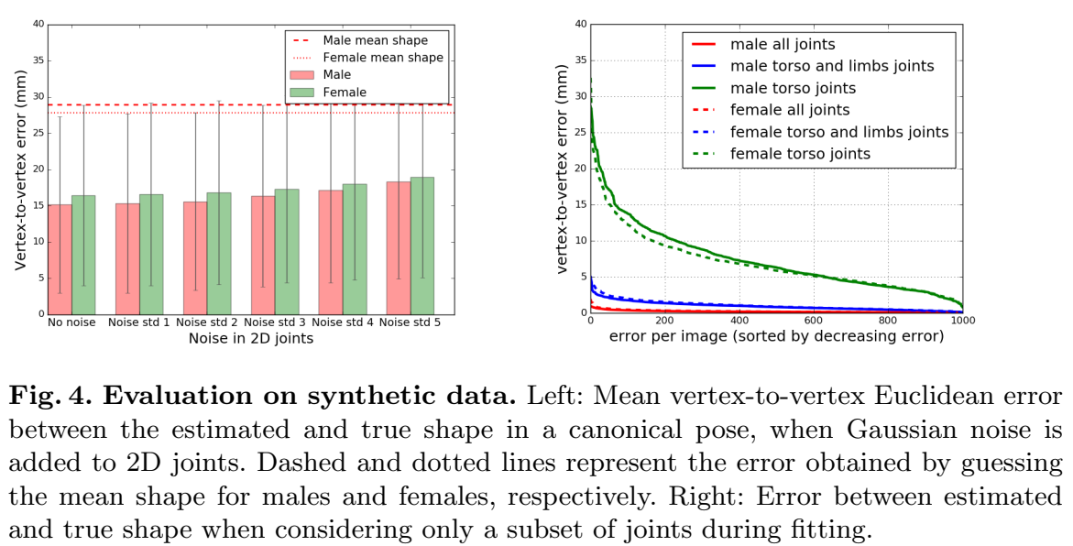
Quantitative evaluation

Slide 19
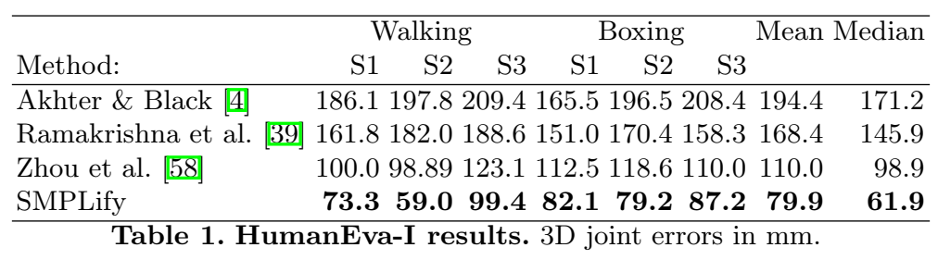
Quantitative evaluation: Real Data
HumanEva dataset: Predict 3D pose from 2D joints.
2D joints
SMPL model
MoSh
Learned Mapping
(Linear regressor)
3D skeletal representation of HumanEva
body shape and pose
Body vertices
the ground truth focal length

Slide 20
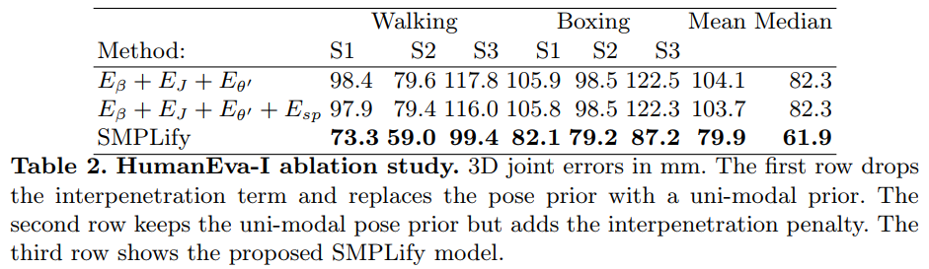
Ablation study: 3D pose from 2D joints
Interpenetration term does not have a significant impact on the 3D joint error. However, qualitatively, makes difference in more complex datasets
Uses a single Gaussian

Slide 21
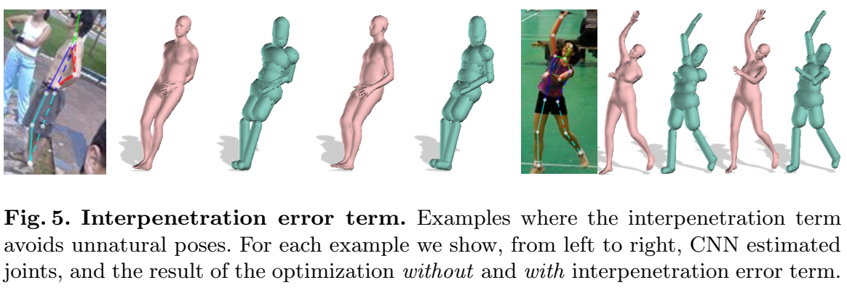
Effect of Interpenetration error term
Without Interpenetration
With Interpenetration

Slide 22
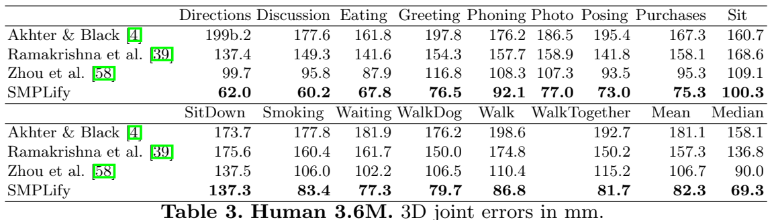
Quantitative evaluation: Human3.6M dataset

Slide 23
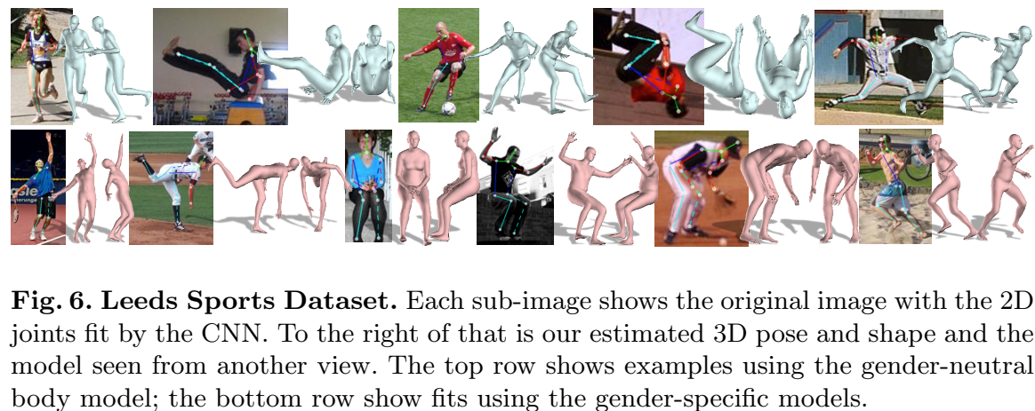
Qualitative evaluation
On Leeds Sports Dataset

Slide 24
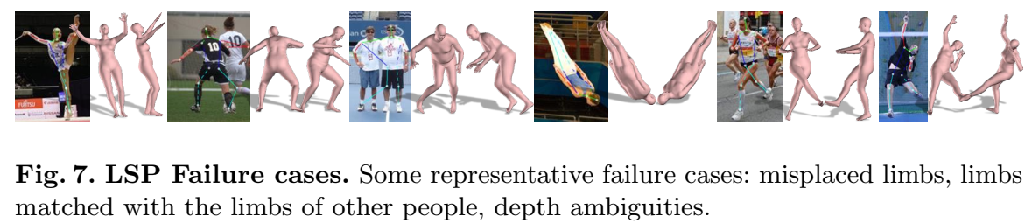
Qualitative evaluation: failure cases
Reason:
Failure of DeepCut on 2D joints prediction
Depth ambiguities

Slide 25
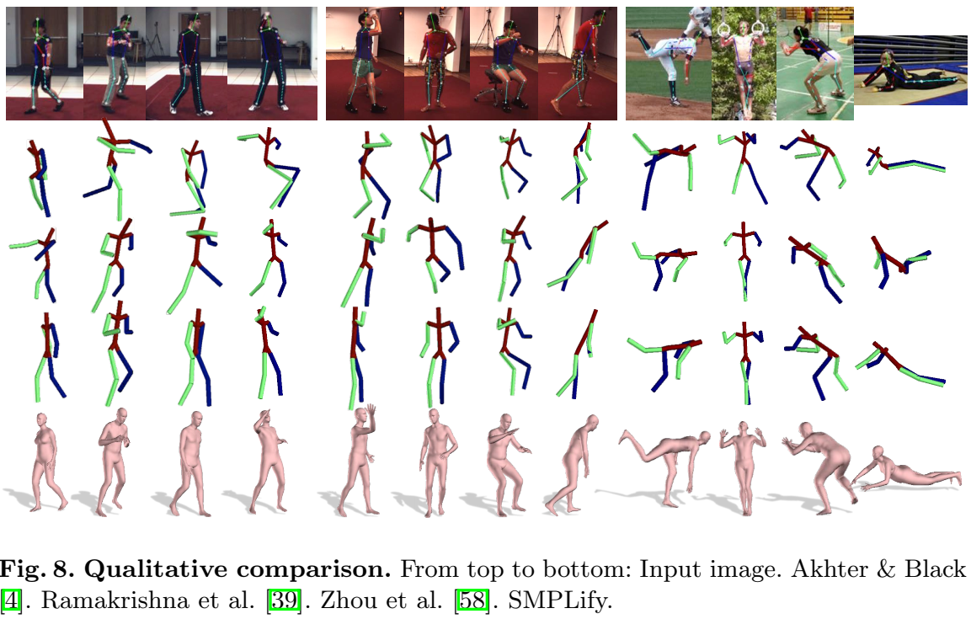

Slide 26
Conclusion
SMPLIfy: a fully automated method for estimating 3D body shape and pose from 2D jojints in a single images.
Use SMPL body model
Minimizing the error between the projected joints of the model and the estimated 2D joints.

Slide 27
Expressive Body Capture: 3D Hands, Face, and Body from a Single Image
Thai Thanh Tuan
Create: 13th July 2021

Slide 28
Introduction
Code: https://github.com/vchoutas/smplify-x
Project page: https://smpl-x.is.tue.mpg.de/
Paper: Expressive Body Capture: 3D Hands, Face, and Body from a Single Image
Conference: CVPR 2019
Paper: https://ps.is.tuebingen.mpg.de/uploads_file/attachment/attachment/497/SMPL-X.pdf
Supplementary: https://ps.is.tuebingen.mpg.de/uploads_file/attachment/attachment/497/SMPL-X.pdf

